Slide 1
Doodle Dash
Making sure your down-time is as fun as it could be.

Slide 2
What is “Doodle Dash”
Rhythm-based running game that will be free-to-play
Customizable
Various genres of music giving off a different experience for every level

Slide 3
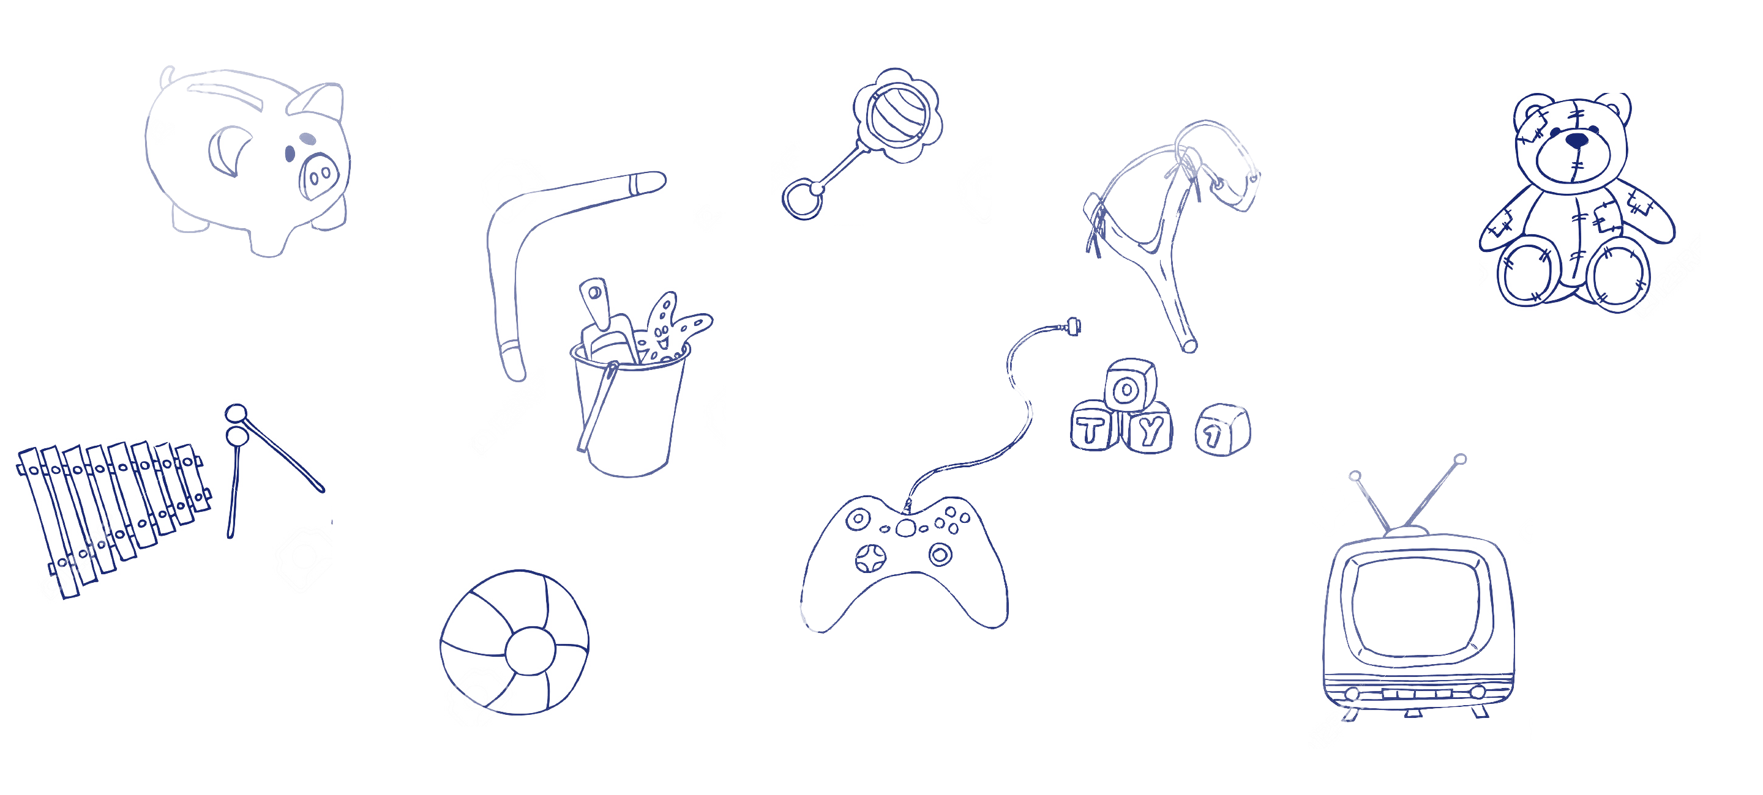

Slide 4
System Purpose

Slide 5
Goals
We would want to help people destress the hectic everyday life by providing a simplistic yet super fun game to play that delivers a better entertainment value compared to existing games.

Slide 6
Benefits Chain Diagram
ASSUMPTION
Every iteration added in every iteration works.
Create user interface for the mobile application.
Android Developers
Social Media Developers
Provide images for the game.
Link Unity and Android.
Add social media functionality to the game.
Artist
Unity Developers
Unity Developers
Design levels and make the game play in Unity.
Game is ready to be released.
Playable game.

Slide 7
System Boundary

Slide 8
Element Relationship Diagram
User

Slide 9
Core Features
Level Design
Responsive Controls
Customizable Settings
Interactive Menus
Local Leaderboard

Slide 10
Additional Features
Online leaderboard
Social Media Connectivity
Ghosting Friend Challenges
Level Creator

Slide 11
Win-Win Agreements

Slide 12
Prototype

Slide 14
Architecture

Slide 15
Quality Management Plan Strategy

Slide 16
Test Plans and Cases

